Slide 1
VIBRATION REDUCTION OF A QUARTER – CAR SUSPENSION SYSTEM USING REINFORCEMENT LEARNING
By Dhruv Mehta
Advisor – Dr. Sriram Malladi

Slide 2
Overview
Introduction – AI in Vehicles
Differences Between Supervised, Unsupervised and Reinforcement Learning
Reinforcement Learning – Basic Algorithm
Problem Statement
RL Implementation using Q-Learning Technique

Slide 3
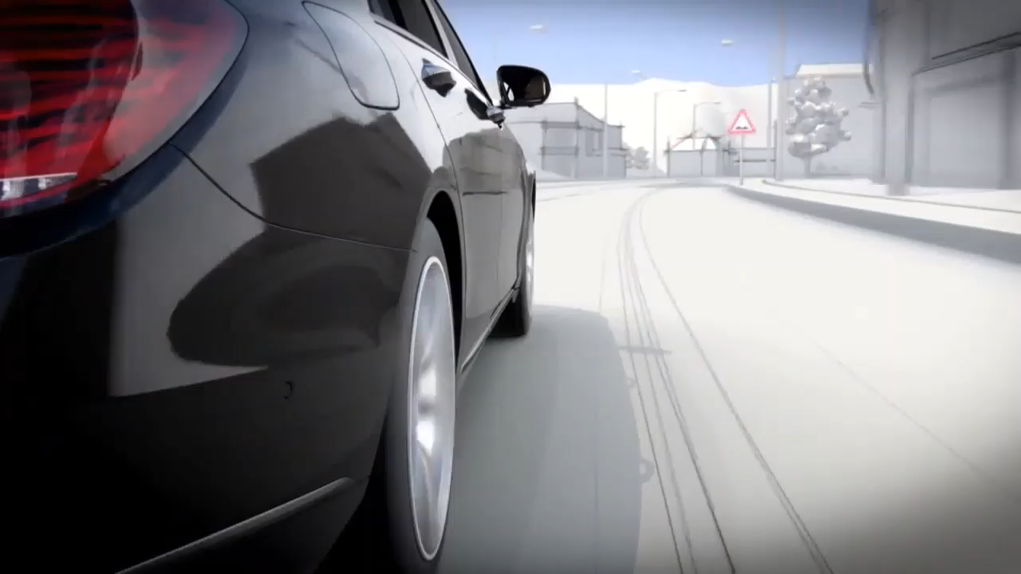
AI in Vehicles

Slide 4
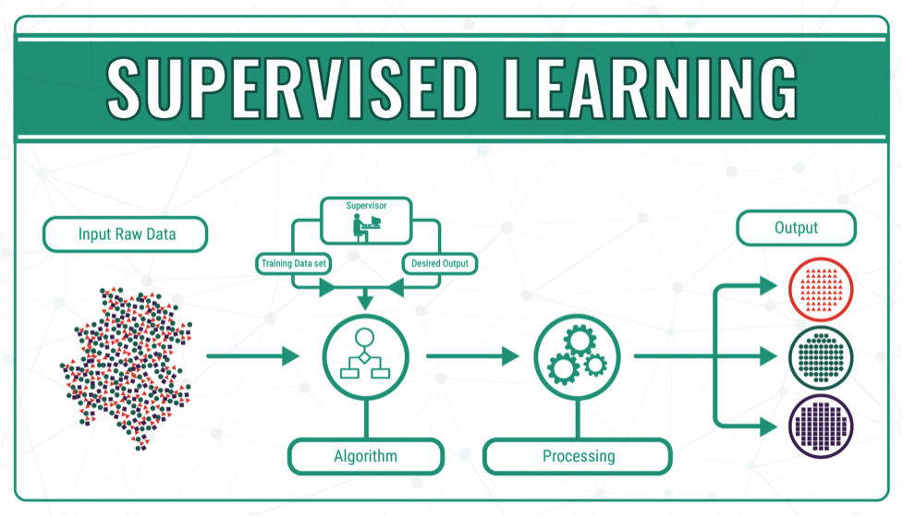
Types of Machine Learning Approaches

Slide 5
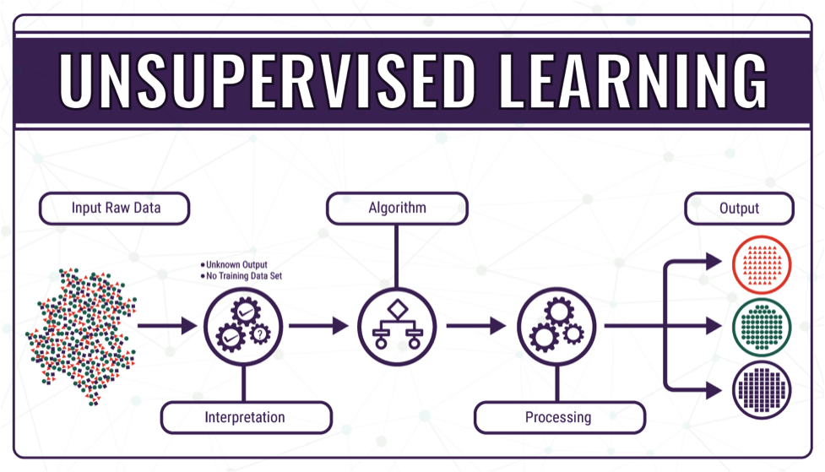
Types of Machine Learning Approaches

Slide 6
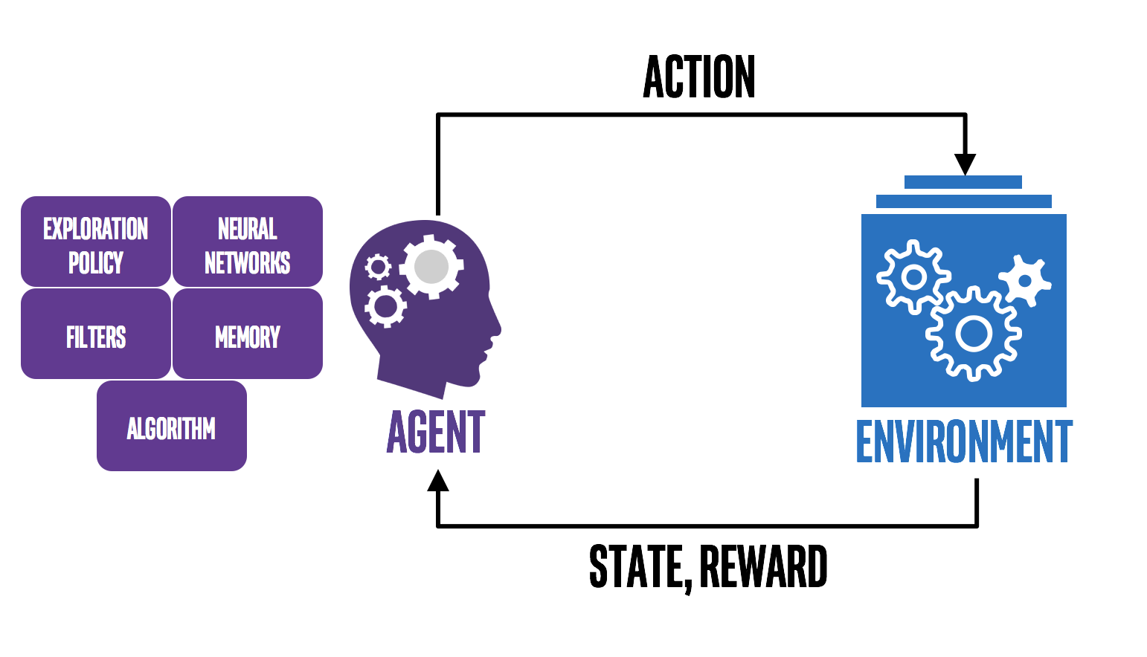
Types of Machine Learning Approaches

Slide 7
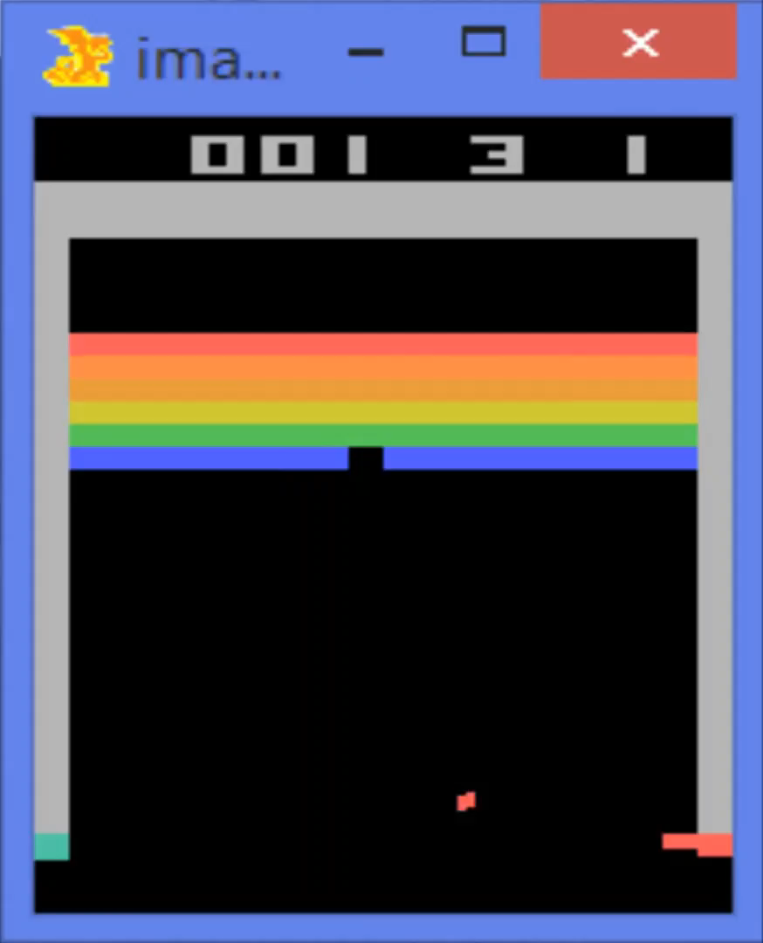
RL Example

Slide 8
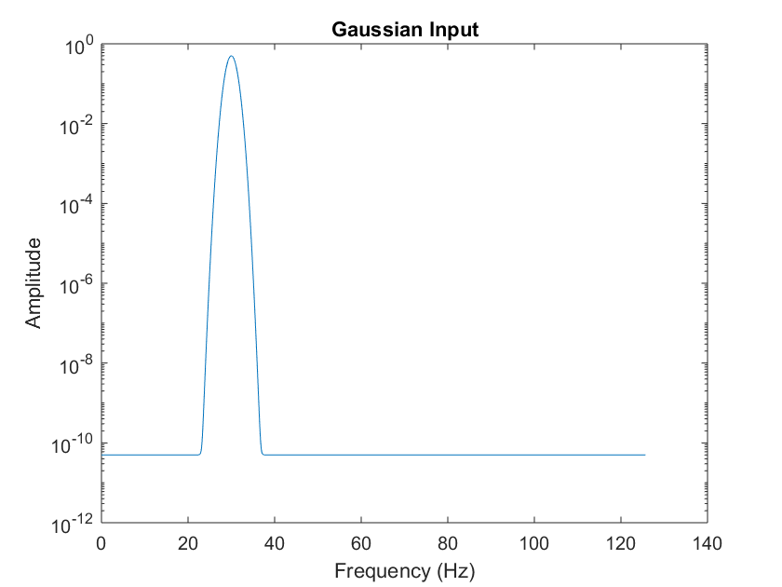
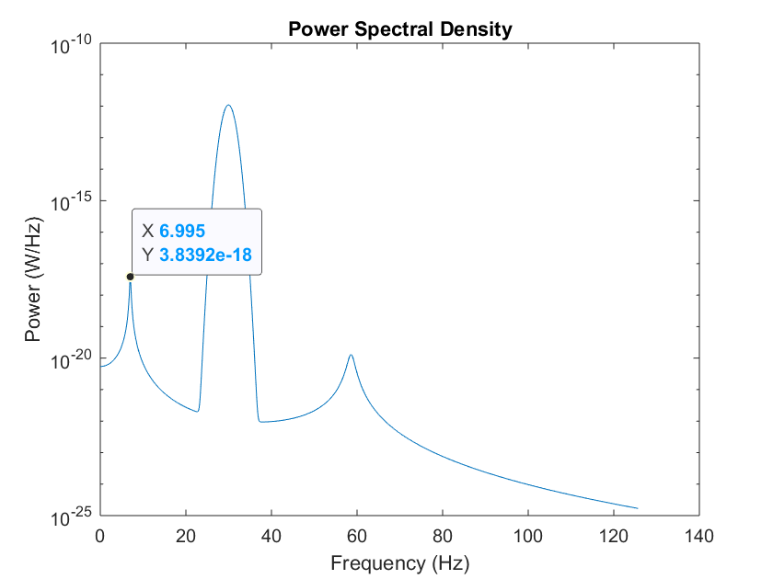
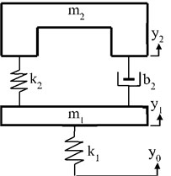
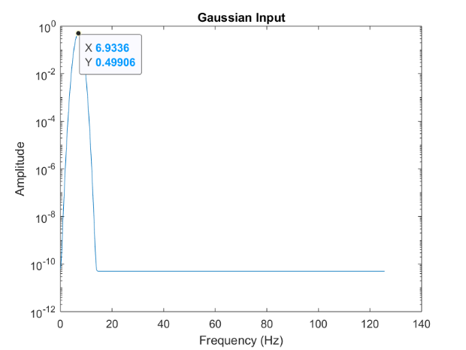
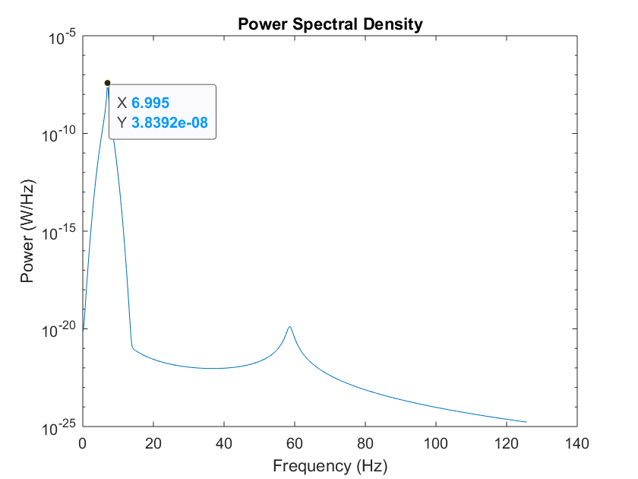
Problem Statement
We assume a linear suspension model having a sprung mass (m₂ = 300 Kg), an Unsprung mass (m₁ = 60 Kg) and a Spring Mass Damper system (K₂ = 16000 N/m, b₂ = 50 N-s/m, K₁ = 190000 N/m) undergoing a random gaussian disturbance
Two inputs, one at 30 Hz and other at 6.933 Hz
Two outputs, one at random and other at resonance

Slide 9
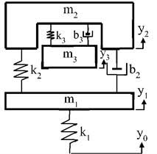
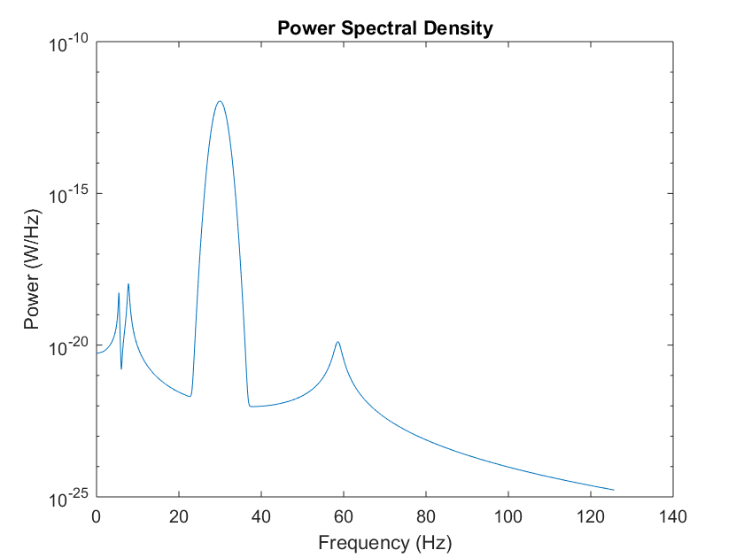
How do we solve the problem?
By using an Active Tuned Spring Mass System (TSM) on the sprung mass (m₃,k₃,b₃) with variable stiffness to absorb vibrations in such scenarios

Slide 10
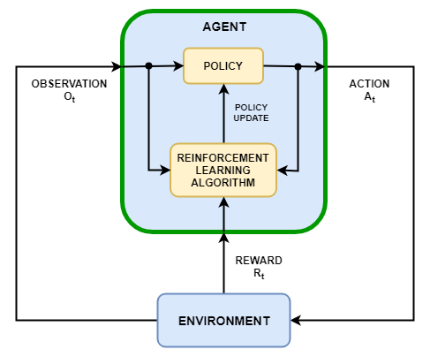
Q-Learning RL Algorithm Implementation for TSM’s variable stiffness
Changing TSM’s stiffness
PSD Peaks
Quarter – Car Suspension System and TSM system

Slide 11
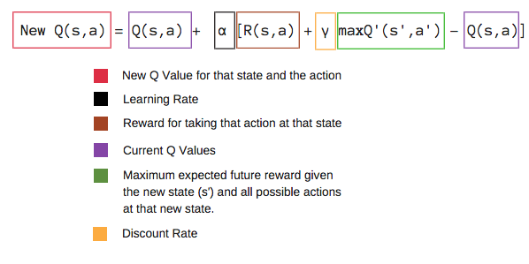
Key formula and Parameters
The Bellman Equation

Slide 12
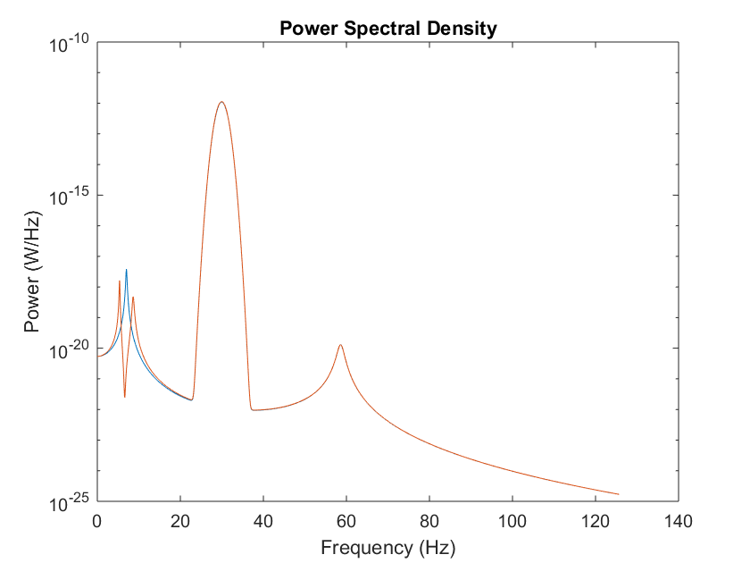
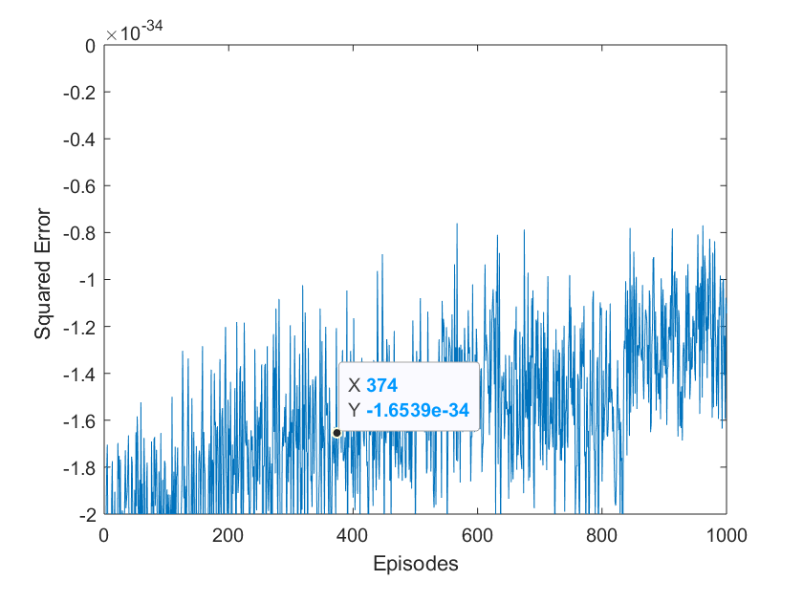
Results

Slide 13
Pros of RL
Can be used to solve complex problems
No training data set needed, learns from experience
RL mimics human behavior, hence close to achieving perfection

Slide 14
Cons of RL
Too much RL can diminish results due to overload of states
Not preferred for solving simple problems
Needs a lot of data for computation and is also computationally expensive.

